Slide 1

KCS056 APPLICATION OF
SOFT COMPUTING
UNIT-2
Prepared By- MR. Ashish Tiwari
ASSISTANT PROFESSOR
DEPARTMENT OF COMPUTER SCIENCE ENGINEERING
UNITED COLLEGE OF ENGG. & RESEARCH, PRAYAGRAJ

Slide 2
Unit -2
Neural Networks-II (Back Propagation Network
Back-Propagation Network, topics : Background, what is back-prop network ? learning AND function, simple learning machines – Error measure, perceptron model Perceptron learning rule, Hidden Layer, Back-Propagation Learning : learning by example, single layer artificial neural network multi-layer feed- forward back-propagation network, computation in input, hidden and output layers, error calculation. Back-propagation algorithm for training network - basic loop structure, step-by-step procedure, numerical example. factors affecting back propagation training, applications.

Slide 3
LECTURE - 7

Slide 4
Outlines of Today's Lecture
Factor Affecting the Backpropagation Training.
Momentum Factor.
Learning Co-efficient.
Sigmoidal Gain.
Threshold Value.

Slide 5
FACTOR AFFECTING THE BACKPROPAGATION TRAINING:
A proper selection of tuning parameters such as momentum factor, learning co-efficient, sigmoidal gain and threshold value are required for efficient learning and designing of stable network
Momentum Factor : Weight adjustment is based on Momentum method. The Momentum factor has a significant role in deciding the values of learning rate that will produce rapid learning.
If momentum is zero, then smoothening is minimum and the entire weight adjustment comes from newly calculated change. If momentum is one, new adjustment is ignored and the previous one is repeated.
Between 0 and 1 is a region where the weight adjustment is smoothened by an amount is proportional to the momentum factor. The role of momentum factor is to increase the speed of learning without leading to oscillations.
The momentum also overcomes the effect of level minima. The use of momentum terns will often carry a weight change process through one or local minima to get into global minima.

Slide 6
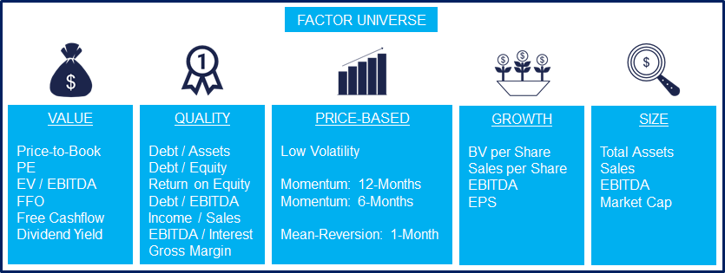
The Momentum strategy, which is defined as buying the winning and selling the losing factors, as measured by their performance over the last 12 months, excluding the most recent month. The momentum factor exists, according to reams of academic literature — but fund managers can’t find a way to profit from it in the real world, according to new research available to clients of Dimensional Fund Advisors.

Slide 7
(ii) Learning Co-efficient : The choice learning co-efficient is a tricky task in back propagation algorithm. The range of learning co-efficient that will produce rapid training depends on the number and types of input patterns.
(iii) Sigmoidal Gain: In some problems, when the weights become large and force the neuron to operate on a· region where sigmoidal function is very flat, a better method of coping with network paralyses is to adjust the sigmoidal gain. By decreasing the scaling factor, we effectively spread out sigmoidal function on wide range to that training proceeds faster.
(iv)ThresholdValue:A point beyond which there is a change in the manner a program executes; in particular, an error rate above which the operating system shuts down the computer system on the assumption that a hardware failure has occurred. Every threshold has a current value, which is displayed by the threshold indicator.

Slide 8
Thresholds can be set on six different parameters:
UtilizationThe percent utilization of an interface.
UnicastsThe number of unicast frames per second.
BroadcastsThe number of broadcast frames per second.
MulticastsThe number of layer 2 multicasts per second.
ErrorsThe number of errored frames per second.
DiscardsThe number of discarded frames per second.

Slide 9
The objective of backpropagation algorithm is to to develop learning algorithm for multilayer feedforward neural network, so that network can be trained to capture the mapping implicitly.
Why We Need Backpropagation?
This is a mechanism used to train the neural network relating to the particular dataset. Some of the advantages of Backpropagation are:
It is simple, fast and easy to program
Only numbers of the input are tuned and not any other parameter
No need to have prior knowledge about the network
It is flexible
A standard approach and works efficiently
It does not require the user to learn special functions

Slide 10
Types of Backpropagation Network
There are two kinds of backpropagation networks. It is categorized as below:
Static Backpropagation
Static backpropagation is one type of network that aims in producing a mapping of a static input for static output. These kinds of networks are capable of solving static classification problems like optical character recognition (OCR).
Recurrent Backpropagation
The recurrent backpropagation is another type of network employed in fixed-point learning. The activations in recurrent backpropagation are fed forward till it attains a fixed value. Following this, an error is calculated and propagated backward. A software, NeuroSolutions has the ability to perform the recurrent backpropagation.
The key differences: The static backpropagation offers immediate mapping, while mapping recurrent backpropagation is not immediate.

Slide 11
Disadvantages of Backpropagation
Disadvantages of backpropagation are:
Backpropagation possibly be sensitive to noisy data and irregularity
The performance of this is highly reliant on the input data
Needs excessive time for training
The need for a matrix-based method for backpropagation instead of mini-batch

Slide 12
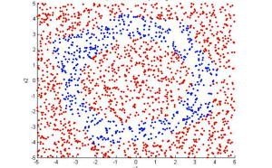
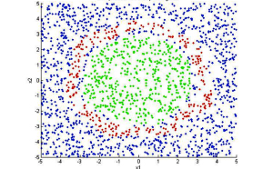
APPLICATION OF BACK PROPAGATION ALGORITHM:
Applications of Backpropagation
The applications are
The neural network is trained to enunciate each letter of a word and a sentence
It is used in the field of speech recognition
It is used in the field of character and face recognition
Classification of Soil :
The objective of soil classification are to find the suitability of the soil for the construction of different structures, embankments, sub-grades and wearing surface. NN is used for the classification of soil. The architecture used for grouping the soil is 6 input neurons, 6 hidden neurons and 1 output neuron. Random points are assigned to a certain class, and the neural network is trained to find the pattern. When training is complete, it will use what it has learned to accurately classify new points.
Here, the network was able to distinguish group 1 (red) from group 2 (blue).
Here, the system was trained to identify three groups.

Slide 13
(ii) Hot Extrusion of Steel:
Hot metal forming has become an attractive process in industry due to achieved energy and material
savings, quality improvement and development of homogeneous properties throughout the component.
NNs are now-a-days applied to the simulation of hot extrusion due to the fact that the finite element
solution of hot forging are very complex and require a lot of computer time.
The NN architecture consist of three layers-two input neurons, eight neurons in a hidden layer and five
output neurons.
Both inputs and outputs are normalized such that values lie between 0 and 1 . The learning rate
and momentum factor are as 0.6 and 0.8 respectively. The error rate reaches at tolerance value at
3500 iterations.
The inputs are die angle and punch velocity and the outputs are forging load, maximum equivalent
strain, maximum equivalent stress, maximum normal velocity and equivalent strain rate. Twenty-four
data set are taken for training and eighteen data-sets are taken for testing;. After neural network is
trained, it is used for inferring.

Slide 14
(iii) Design of Journal Bearing:
Whenever the machine elements move, there are bearing surfaces some of which are lubricated easily,
some of which are lubricated incompletely and with difficulty, and some of which are not lubricated at all.
When there is relative motion between two machine parts, one of which supporting the other, then the
supporting member is called bearing. The bearings are classified as in Fig. 2.11
Fig.2.11 Different Types of Bearings
Out of these bearing, let us consider journal bearing. ·Design of journal bearing is depend upon the load, speed of the journal,
clearance in the bearing, length and diameter of bearing, and kinds of surface.
"NEURONET" is used to train the data and infer the results for test data. A back propagation NN with 8 input neurons, 8 hidden
neurons and 2 output neurons has been used. The learning and momentum factor is 0.6 and 0.9 respectively. Although,
5000 iterations have been performed till the error rate converges to the tolerance.
Once the network is trained with the given training data the values are inferred for both training and testing the data.

Slide 15
END

